Slide 1
Translation from PG into TS
邓如妹
2017.10.23

Slide 2
Beverage Vending Machine
Loc={start,select}
Loc0 ={start} Var={nsoda, nbeer}
Act = { bget , sget, coin, ret_coin, refill }
g0 = (nsoda = max ∧ nbeer = max)
Effect
Effect(coin, η) = η
Effect(ret_coin, η) = η
Effect(sget, η) = η[nsoda := nsoda−1]
Effect(bget, η) = η[nbeer := nbeer−1]
Effect(refill,η)=[nsoda:=max, nbeer := max]

Slide 3
True g:coin
nsoda>0 g:sget
start
select
True g:refill
nbeer>0 g:bget
nsoda=0^nbeer=0 g:ret_coin
PG

Slide 4
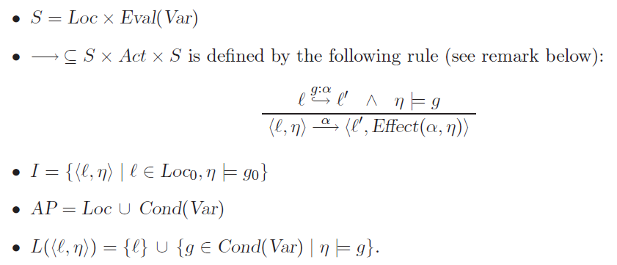
Translation from PG into TS
Definition 2.15. Transition System Semantics of a Program Graph
The transition system TS(PG) of program graph
PG = (Loc, Act,Effect, $→, Loc0, g0)
over set Var of variables is the tuple (S, Act,−→, I,AP, L) where

Slide 5
S=Loc*Eval(Var)
Loc={start,select}
nsoda={0,1,2} 共 |S|= 2*3*3=18种状态
nbeer={0,1,2}

Slide 6
I= {⟨ℓ, η⟩ | ℓ ∈ Loc0, η |= g0}
Initial state: {start,nsoda=2^nbeer=2}

Slide 7
AP = Loc ∪ Cond(Var)
AP={start,select,nsoda=2^nbeer=2,
nsoda=1^nbeer=2, nsoda=2^nbeer=1,
nsoda=0^nbeer=2,nsoda=2^nbeer=0,
nsoda=0^nbeer=2,nsoda=0^nbeer=1,
nsoda=1^nbeer=0, nsoda=0^nbeer=0}

Slide 8
L(⟨ℓ, η⟩) = {ℓ} ∪ {g ∈ Cond(Var) | η |= g}.
L(s1)= {start, nsoda=2^nbeer=2}、 L(s2)= {select, nsoda=2^ nbeer=2}
L(s3)= {start, nsoda=1^nbeer=2}、 L(s4)= {select, nsoda=1^nbeer=2}
L(s5)= {start, nsoda=2^nbeer=1}、 L(s6)= {select, nsoda=2^nbeer=1}
L(s7)= {start, nsoda=0^nbeer=2}、 L(s8)= {select, nsoda=0^nbeer=2}
L(s9)= {start, nsoda=2^nbeer=0}、 L(s10)= {select, nsoda=2^nbeer=0}
L(s11)= {start, nsoda=1^nbeer=1}、 L(s12)= {select, nsoda=1^nbeer=1}
L(s13)= {start, nsoda=0^nbeer=1}、 L(s14)= {select, nsoda=0^nbeer=1}
L(s15)= {start, nsoda=1^nbeer=0}、 L(s16)= {select, nsoda=1^nbeer=0}
L(s17)= {start, nsoda=0^nbeer=0}、 L(s18)= {select, nsoda=0^nbeer=0}

Slide 9
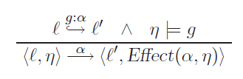
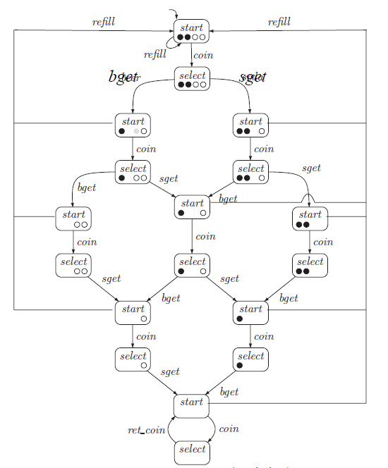
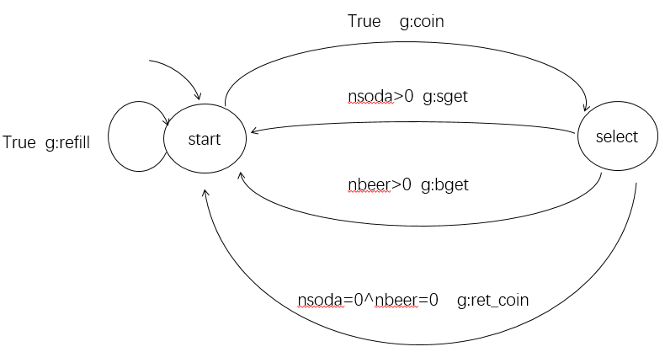
PG
TS

